Slide 1
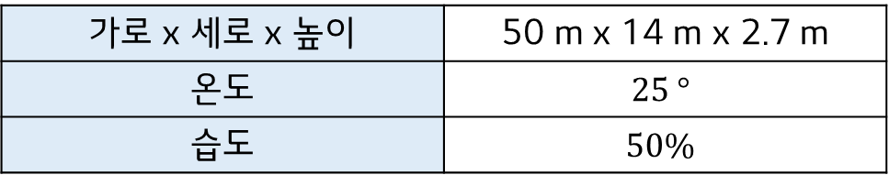
Argo 실험 환경 및 반사판 사양 조사
❑ Argo 실험 환경
가로 x 세로 x 높이 | 50 m x 14 m x 2.7 m
온도 | $$25 °$$
습도 | $$50\%$$

Slide 2
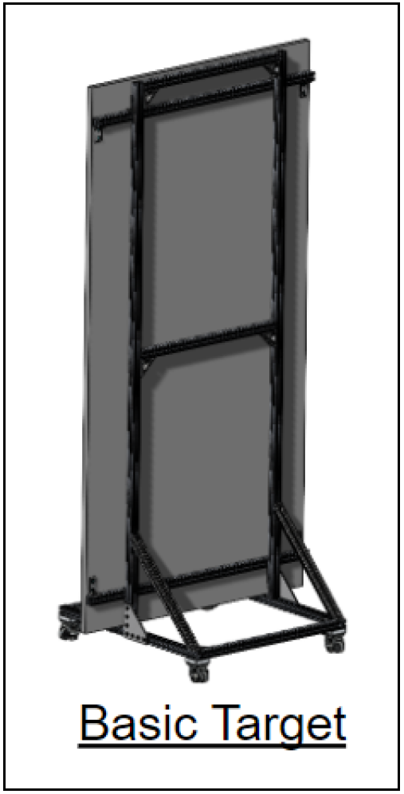
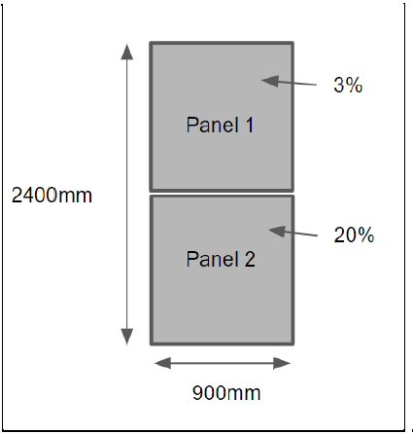
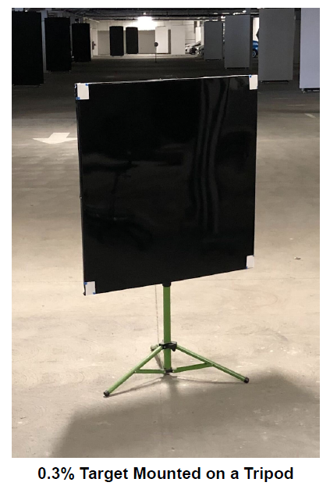
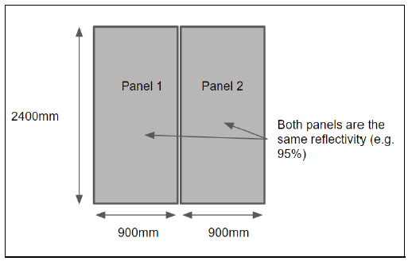
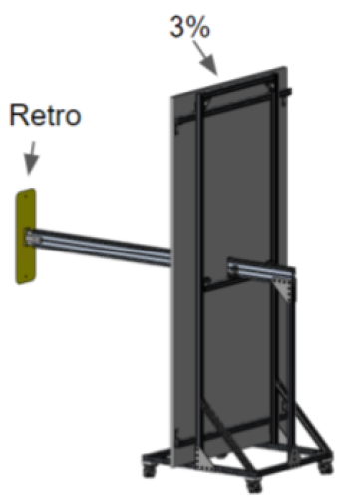
Argo 실험 환경 및 반사판 사양 조사
❑ Argo Target 종류
Basic target
Split panel target
0.3% Automotive Black Target
Type B Target
Dual panel target

Slide 3
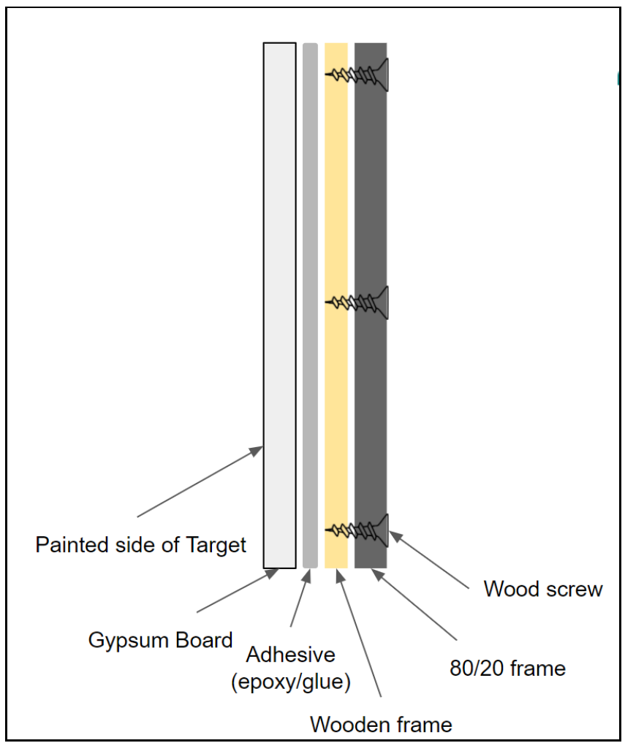
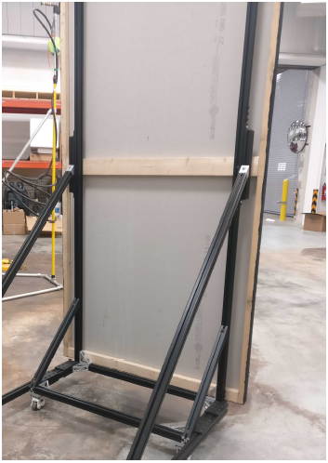
Argo 실험 환경 및 반사판 사양 조사
❑ 1/6 Basic Target
반사도 | 색
~95 % | Rosco 5351, Off Broadway White White
~65 % | Rosco 5735, TV White
~20 % | Rosco 5735, 1000 grams TV White Rosco 5740, 430 grams TV Black
~3 % | Rosco 5740, TV Black
Made of Gypsum Board.
Mounted on a wooden frame.
※ Panel can be made from a variety of substrate materials.
※ The frame of the target is aluminum extrusions.
Should be free of defects.
Basic targets with reflectivity of 3%, 65%, and 95% are used for M-LiDAR.

Slide 4
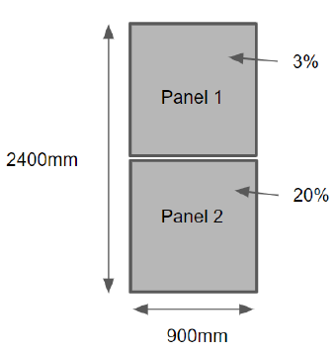
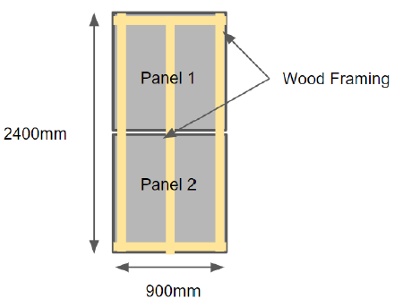
❑ 2/6 Split Panel Target
Front
Rear
A variant of the basic target.
Cut the substrates in half followed by painting.
The gap between the two panels should be minimized as much as possible. A small gap is acceptable.

Slide 5
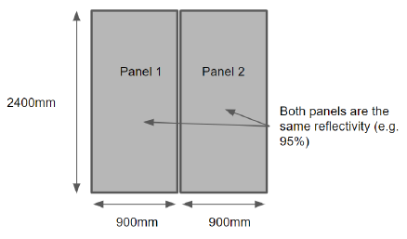
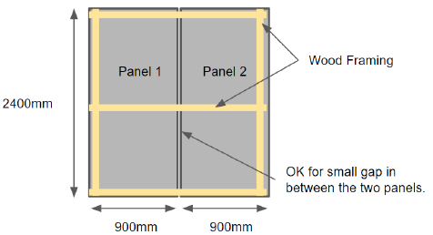
❑ 3/6 Dual Panel Target
Front
Rear
A variant of the basic target.
Consisted of two panels of the same reflectivity mounted side by side on a single frame. Approximately twice as wide as a basic target.
The gap between the two panels should be minimized as much as possible. A small gap is acceptable.

Slide 6
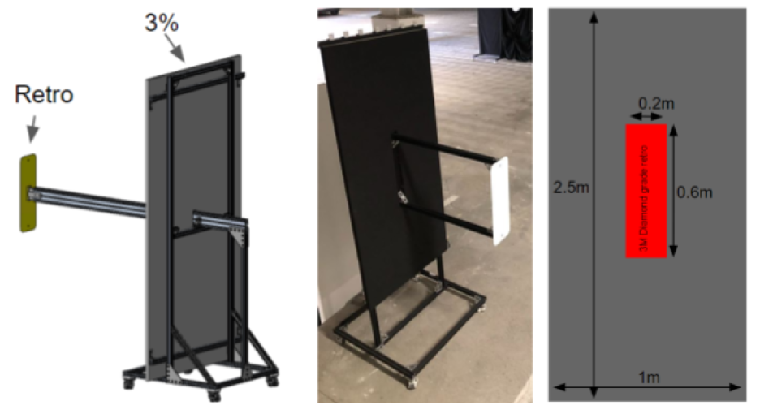
❑ 4/6 Type B Target
Rear
Front
Consisted of a modified basic target that incorporates a retroreflective panel.
A retroreflective panel is parallel to the basic target.
A retroreflective panel is painted with 3% diffuse.

Slide 7
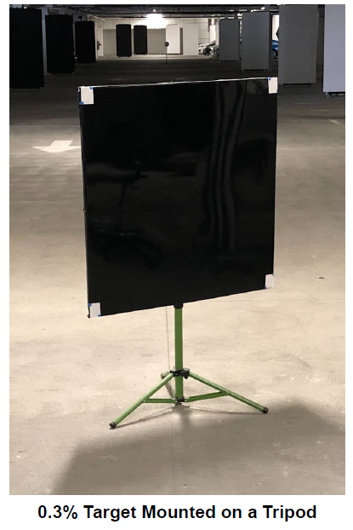
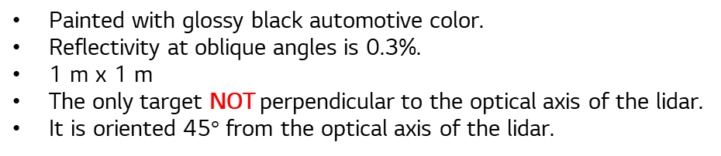
❑ 5/6 0.3% (Automotive Black) Target
Painted with glossy black automotive color.
Reflectivity at oblique angles is 0.3%.
1 m x 1 m
The only target NOT perpendicular to the optical axis of the lidar.
It is oriented 45$°$ from the optical axis of the lidar.

Slide 8
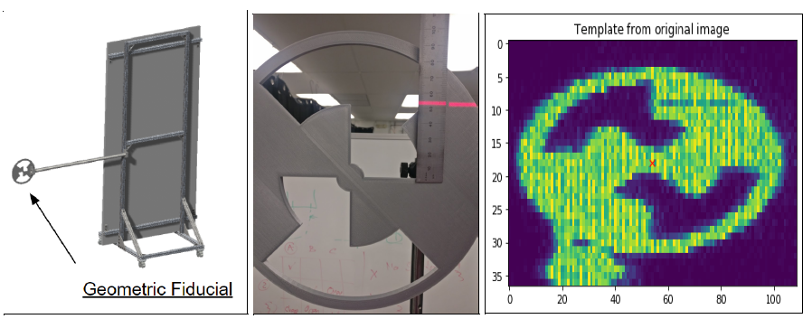
❑ 6/6 Geometric Fiducial Target
Designed to provide precise reference points.
Used for spatial calibration of the lidar.
Mounted 1 m to the side of a basic target.
Should be aligned with the optical axis of the lidar.
Should be adjustable to be aligned with the optical axis.

Slide 9
안녕하세요 김성기입니다.
일반적인 Procedure 정리해서 공유드립니다.
석고 보드 구매 – 인터넷
사이즈 사양 결정, 구매 및 준비(Amber Ref 확인 중)
목공소 – 해마루 목공소
석고보드 절삭 및 나무 액자 제작 및 조립
도료 스프레이 – 신원아트
도료 선정(Amber Ref 확인 중)
도료 및 액자에 담긴 석고 보드 보내어 코팅 진행(1일 1회 스프레이 x 2)
철제 프레임 – 경기FA
철제 프레임 제작 및 석고보드 고정
Uniformity 확인
Spectrometer 측정(Ocean Insight社 FLAMENIR)
차트 셋업
거리 및 방위에 대한 정보는 추후 확인 예정
기본적인 업체들과의 거래는 제스텍 통해서 발주 진행하였습니다.

Slide 10
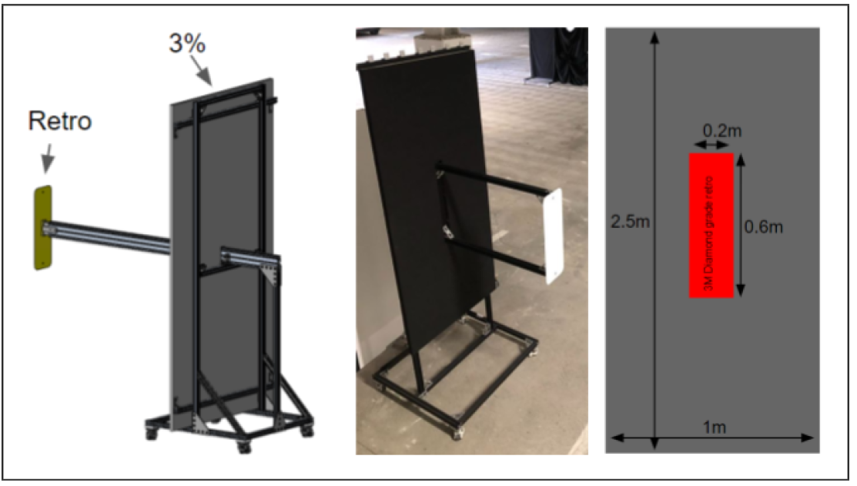
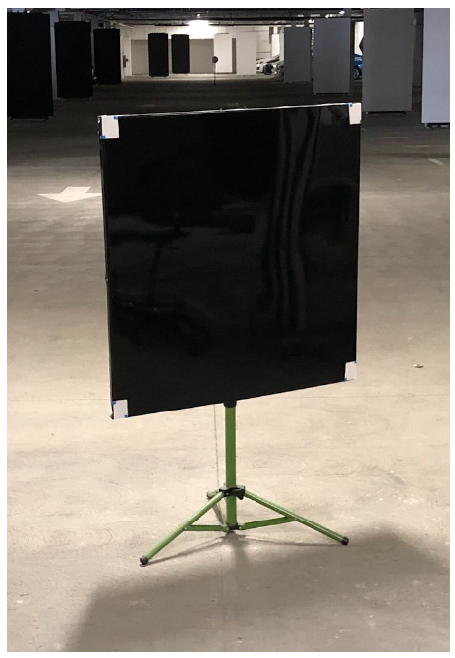
Calibration target
Type B target
0.3%(automotive black) target
Modification version of a basic target
It incorporates a retro-rflective panel that is parallel and offset in range from basic target
Basic target: 3% diffuse equivalent
Retroreflector: reflects beam back to its source direction
1m X 1m
It is tilted by 45deg from the LiDAR optical axis
Mirror like surface

Slide 11
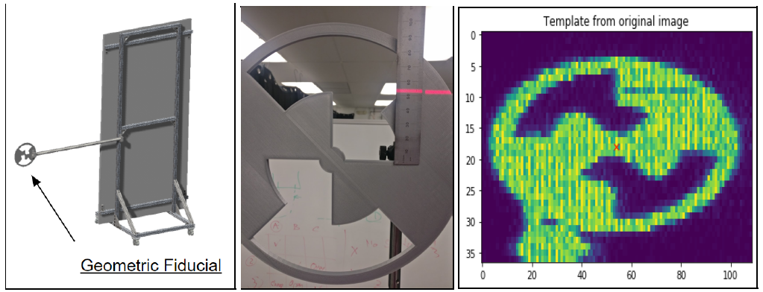
Geometric fiducial target
To provide a precise reference point cloud shape
The reference point is used for spatial calibration of the LiDAR
Mounted 1m to the side of a basic target
Has to be aligned with the optical axis of the LiDAR

Slide 12
